Slide 1
Cover Sheet : Faculty name : Computers and Artificial Intelligence Course name : Selected Topics – 1 Team number : 2
Member Name | Member ID
يوسف هاني محمد محمد | 202001112
معتز محمد بصرى حجاج | 202000926
صموئيل سمير نسيم كامل | 202000471
محمد محمود الدمرداش لاشين | 201900728
محمود عزت عبد النبى عبد الجواد | 202000851
احمد حمدى محمود الشويمى | 202000031
محمد حسن عبدالحى احمد | 202000743
محمد ماهر حسين فرحات | 202000813

Slide 2
Paper Detailes Authers Names : Atul Sharma and Gurbakash Phonsa. Paper Name : Image Classification Using CNN year of publication : International Conference on Innovative Computing and Communication (ICICC) in 2021 Dataset Used : Vegetable Image Dataset the Used Algorithm : CNN Model Result : Training Accurecy : Test Accurecy :

Slide 3
Project Description Document General Information on the selected dataset Dataset Name: Vegetable Image Dataset Dataset Link : https://www.kaggle.com/datasets/misrakahmed/vegetable-image-dataset total number of samples : 21 000 Number Of Classes : 15 1- Bean 2- Bitter_Gourd 3- Bottle_Gourd 4- Brinjal 5- Broccoli 6- Cabbage 7- Capsicum 8- Carrot 9- Cauliflower 10- Cucumber 11- Papaya 12- Potato 13- Pumpkin 14- Radish 15- Tomato

Slide 4
Training : 1- ration of Total : 71.4285% 2- image number : 15 000
Implementation details
Test : 1- ration of Total : 14.2857 % 2- image number : 3000
Validation : 1- ration of Total : 14.2857 % 2- image number : 3000

Slide 5
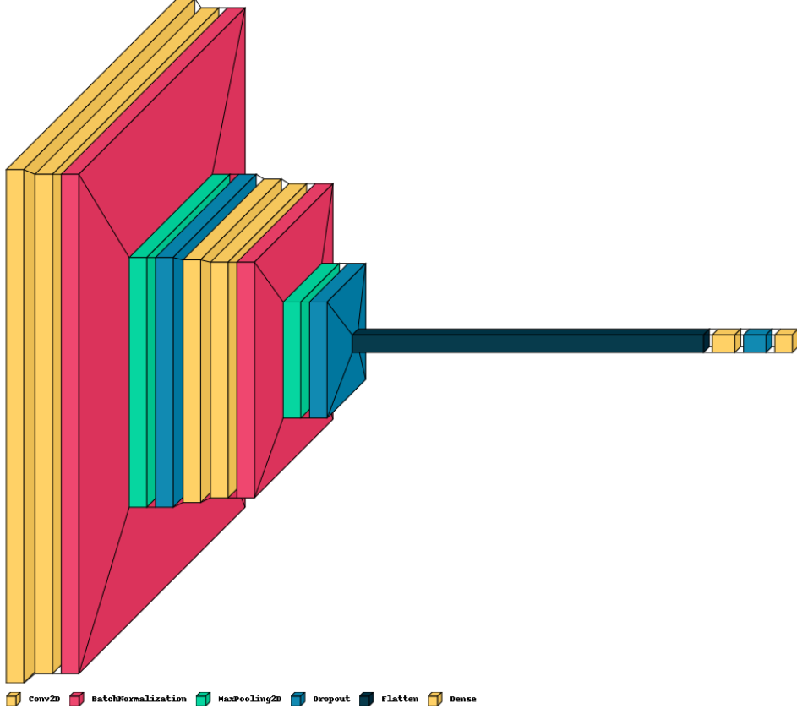
block diagram of The implemented model

Slide 6
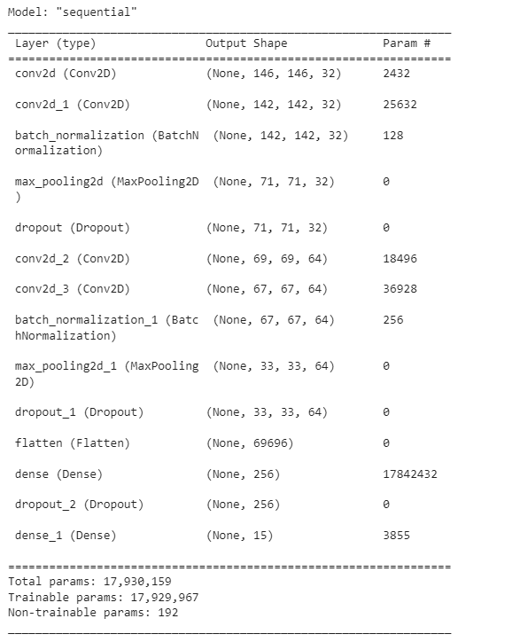
main steps :

Slide 7
1- Add a Conv2D layer with 32 filters and 5x5 kernel size, with ReLU activation function and input_shape as specified above. 2- Add a second Conv2D layer with 32 filters and 5x5 kernel size, with ReLU activation function. 3- Add BatchNormalization layer to normalize the activations of the previous layer. 4- Add MaxPooling2D layer with pool size of 2x2 to reduce the spatial dimensions of the feature map. 5- Add Dropout layer to randomly drop out 25% of the neurons in the layer to prevent overfitting. 6- Add another two Conv2D layers with 64 filters and 3x3 kernel size, with ReLU activation function. 7- Add another BatchNormalization layer. 8- Add another MaxPooling2D layer. 9- Add another Dropout layer. 10 - Flatten the output of the previous layer for use in a fully connected neural network. 11- Add a Dense layer with 256 neurons and ReLU activation function. 12- Add another Dropout layer. 13- Add a final Dense layer with 15 neurons, corresponding to the number of classes in the dataset, and Softmax activation function to output the class probabilities.

Slide 8
filters: The number of output filters in the convolutional layers. In this code, there are two Conv2D layers with 32 and 64 filters respectively.
kernel_size: The size of the convolutional kernel. In this code, the first Conv2D layer has a kernel size of (5,5) and the second Conv2D layer has a kernel size of (3,3).
activation: The activation function used in the convolutional and dense layers. In this code, it is 'relu' for all layers except for the last dense layer which uses 'softmax'.
input_shape: The shape of the input data. In this code, it is set to (size, size, 3) where size represents the size of the input image and 3 represents the number of color channels (RGB).
pool_size: The size of the pooling window. In this code, it is set to (2, 2) for both MaxPool2D layers.
rate: The fraction of input units to drop in the Dropout layers. In this code, it is set to 0.25 for the two Dropout layers before the MaxPool2D layers and 0.5 for the Dropout layer after the first dense layer.
units: The number of units in the dense layers. In this code, the first dense layer has 256 units and the second dense layer has 15 units.
hyperparameters used in model

Slide 9
learning_rate: The step size at which the optimizer takes steps towards finding the minimum of the loss function.
epochs: The number of times the training data will be passed through the neural network during training.
opt : The optimizer to use. Here, we are using the Adam optimizer with a specified learning rate and decay, which helps the optimizer converge faster and avoid overfitting.
loss: The loss function used to calculate the error between the predicted and actual output of the model. Here, we are using sparse categorical cross-entropy, which is commonly used for multi-class classification problems.
metrics: The evaluation metric (s) to use for the model. Here, we are using accuracy, which measures the proportion of correctly classified samples.
rotation_range: The maximum degrees of rotation applied to the image.
zoom_range: The range by which images can be zoomed in or out.
width_shift_range and height_shift_range: The maximum proportion of the image size by which the image can be shifted horizontally and vertically.
shear_range: The maximum shear intensity.
horizontal_flip and vertical_flip: Whether or not to apply horizontal and vertical flips.

Slide 10
batch_size: The number of samples per batch. epochs: The number of epochs to train the model for. validation_data: The data used for validation during training.

Slide 11
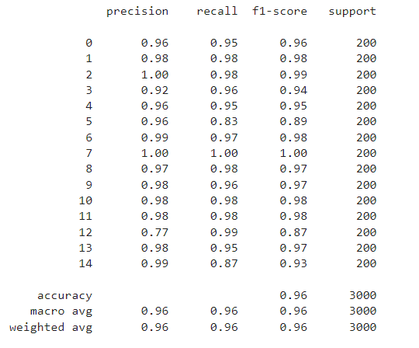
94 / 94 [==============================] - 2s 17ms/step - loss: 0.2070 - accuracy: 0.9573 Test Loss is 0.2070130854845047 Test Accuracy is 0.9573333263397217
Results details

Slide 12
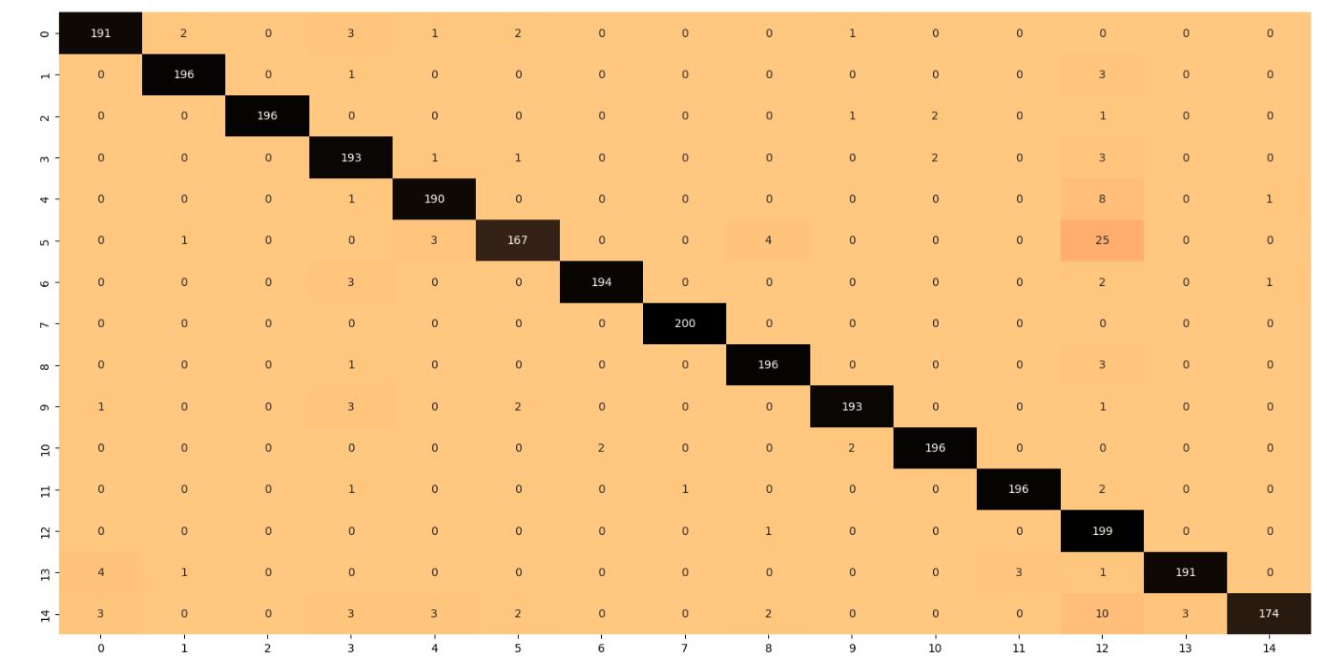
Results details
The confusion_matrix for Test :

Slide 13
Results details

